Slide 1
<SVG>

Slide 2
WHAT IS SVG?
Vector Graphics for Web
Based on XML
Easy to implement
Supported by all major web browsers

Slide 3
ADVANTAGES-
Drastically small in size.
Scalable to any resolution.
All attributes can be animated
Generates Vector equations for shapes

Slide 4
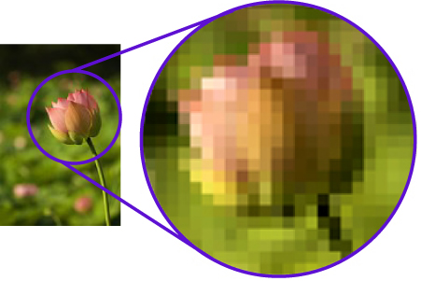
RASTER IMAGE?

Slide 5
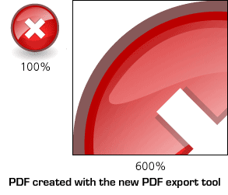
VECTOR GRAPHICS?

Slide 6


POWER OF SVG
1.2 MB
110 KB

Slide 7
HOW TO CREATE ONE?
<svg viewBox="0 0 500 500" width="500" height="500" >
<!-- ALL MAGIC HAPPENS HERE :) -->
</svg>

Slide 8
SVG TAGS
Rectangle <rect>
Circle <circle>
Polyline <polyline>
Polygon <polygon>
And more….

Slide 9
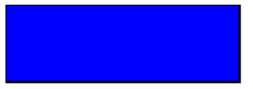
SVG TAGS
Rectangle Tag
<svg viewBox="0 0 500 500" width="500" height="500" >
<rect width="300" height="100" fill=”blue” stroke-width="2" stroke="black"/>
</svg>

Slide 10
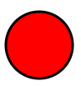
SVG TAGS
Circle Tag
<svg viewBox="0 0 500 500" width="500" height="500" >
<circle cx="50" cy="50" r="40" stroke="black" stroke-width="3" fill="red" />
</svg>

Slide 11
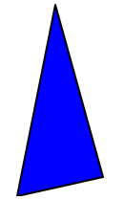
SVG TAGS
Polygon Tag
<svg viewBox="0 0 500 500" width="500" height="500" >
<polygon points="200,10 250,190 160,210" fill=”blue” stroke-width="2" stroke="black" />
</svg>

Slide 12
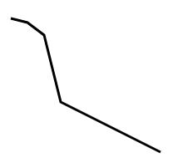
SVG TAGS
Polyline Tag
<svg viewBox="0 0 500 500" width="500" height="500" >
<polyline points="20,20 40,25 60,40 80,120 120,140" fill=”none” />
</svg>

Slide 13
and now
THE MOST POWERFUL TAG

Slide 14
PATH TAG
<path d=”” />
M = moveto
L = lineto
H = horizontal lineto
V = vertical lineto
C = curveto
Q = quadratic Bézier curve
A = elliptical Arc
Z = closepath

Slide 15
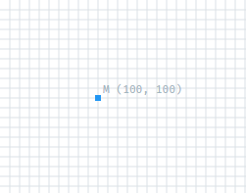
M: moveto
<path d=”M 100,100” />
M says, in a metaphorical sense, pick up the pen and move it to the exact location 100, 100. Don't draw anything just yet, just move the location of the Pen.

Slide 16
Absolute vs Relative Paths?
M 100,100 means "Pick up the pen and move it to the exact coordinates 100,100"
m 100,100 means "Move the Pen 100 down and 100 right from wherever you currently are."

Slide 17
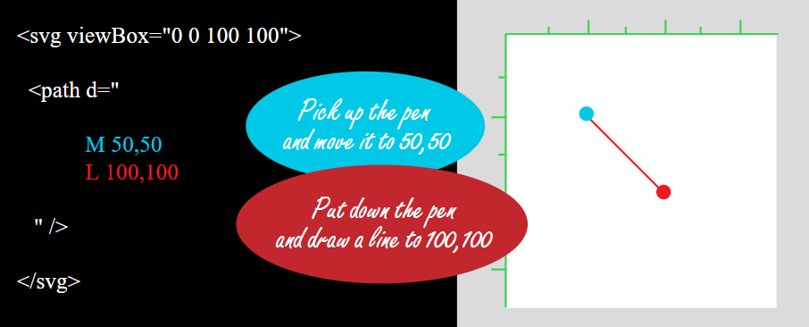
L: lineto

Slide 18
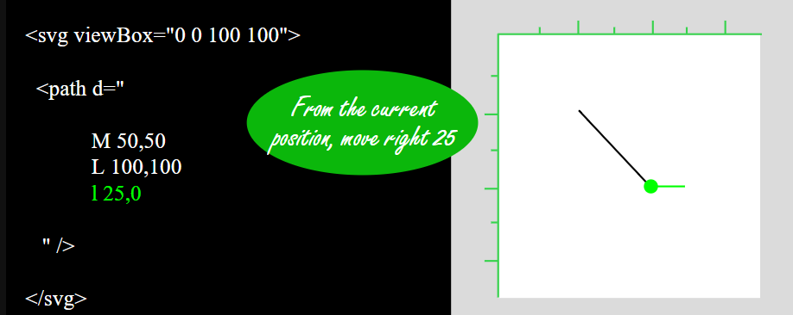
l: lineto

Slide 19
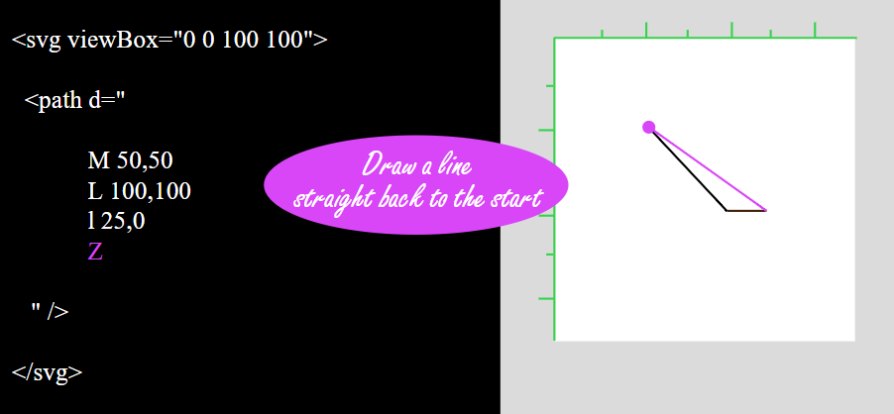
Z: close path

Slide 20
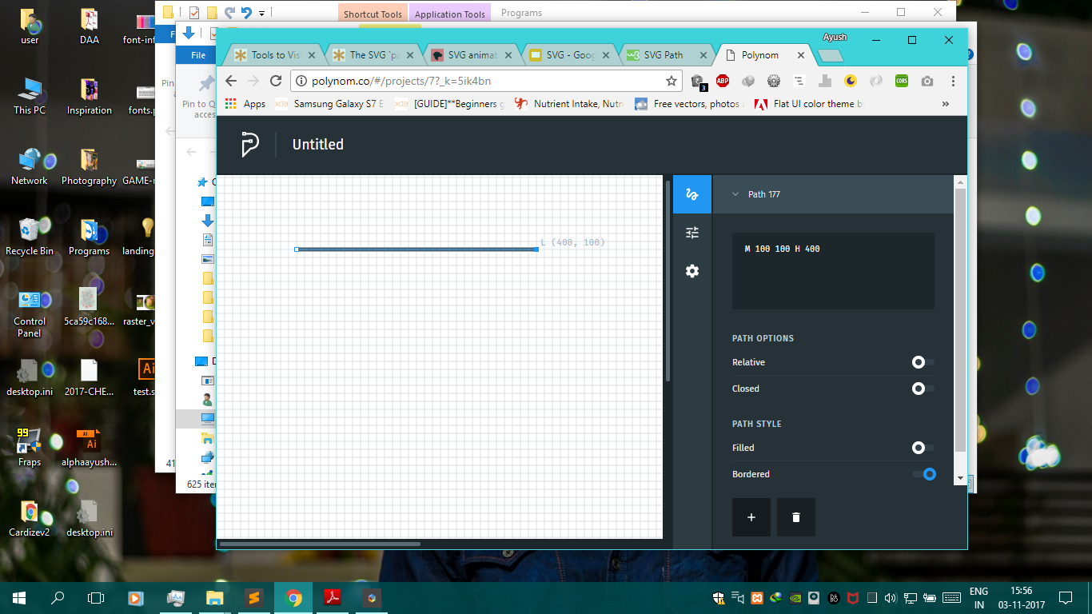
H: Horizontal lineto

Slide 21
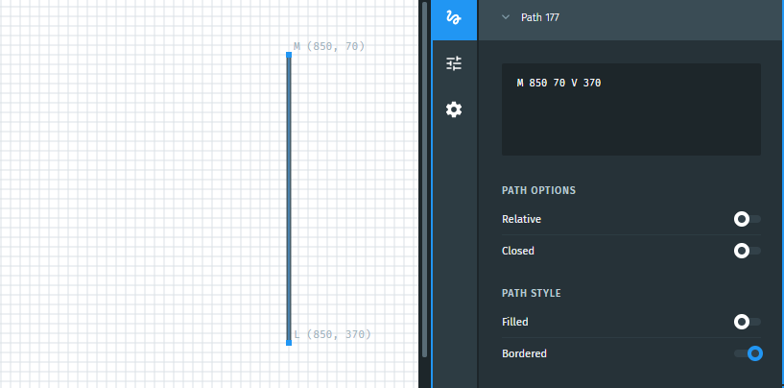
V: Vertical lineto

Slide 22
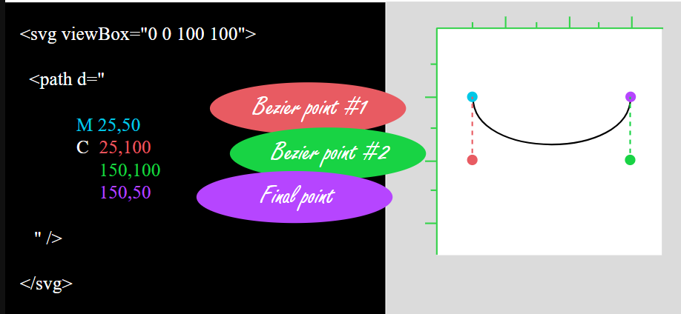
C: curveto
Notes:
https://codepen.io/thebabydino/full/EKLNvZ/

Slide 23
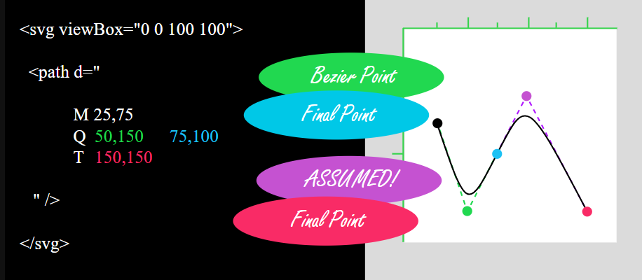
Q: Quadratic curveto

Slide 24
CHEAT SHEET #1
M | x,y | Move to the absolute coordinates x,y
m | x,y | Move to the right x and down y (or left and up if negative values)
L | x,y | Draw a straight line to the absolute coordinates x,y
l | x,y | Draw a straight line to a point that is relatively right x and down y (or left and up if negative values)
H | x | Draw a line horizontally to the exact coordinate x
h | x | Draw a line horizontally relatively to the right x (or to the left if a negative value)
V | y | Draw a line vertically to the exact coordinate y
v | y | Draw a line vertically relatively down y (or up if a negative value)
Z / z | - | Draw a straight line back to the start of the path

Slide 25
CHEAT SHEET #2
C | cX1,cY1 cX2,cY2 eX,eY | Draw a bezier curve based on two bezier control points and end at specified coordinates
c | cX1,cY1 cX2,cY2 eX,eY | Same with all relative values
Q | cX,cY eX,eY | Draw a bezier curve based a single bezier control point and end at specified coordinates
q | cX,cY eX,eY | Same with all relative values
T | eX,eY | Basically a Q command that assumes the first bezier control point is a reflection of the last bezier point used in the previous Q or T command
t | eX,eY | Same with all relative values

Slide 26
IT’S COMPLICATED
Notes:
http://polynom.co/
http://editor.method.ac/

Slide 27
SVG ANIMATION

Slide 28
SMIL
SMIL (pronounced “smile”) stands for Synchronized Multimedia Integration Language
<animate> tag is used to animate the attributes of circle, rectangle, etc
<animateTransform> tag is used to animate the Transform attributes
Notes:
TRANSFORM- rotate, scale

Slide 29
<animate> tag
<circle cx="0" cy="50" r="15" fill="blue" stroke="black" stroke-width="1">
<animate attributeName="cx"
from="0" to="100"
dur="5s”
repeatCount="indefinite"
fill=”freeze”/>
</circle>
Notes:
https://codepen.io/ayush013/pen/YEwbdm

Slide 30
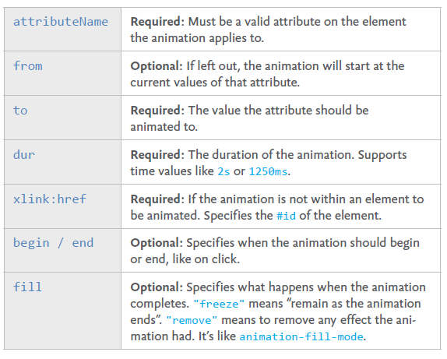
<animate> tag

Slide 31
<animateTransform> tag
<polygon points="60,30 90,90 30,90">
<animateTransform attributeName="transform"
type="rotate"
from="0 60 70"
to="360 60 70"
dur="10s"
repeatCount="indefinite" />
</polygon>
Notes:
https://codepen.io/ayush013/pen/rYxEEB

Slide 32
Values Attribute
<path class="st6" d="M215.8 107.8l4.4 46.1 41-32.3z">
<animate attributeName="fill" begin="2s" dur="5s" fill="remove" repeatCount="indefinite"
values="#FFB908; #FFE165; #F7B848; #FBD258; #FFEDA3; #FDC74A; #FBC74A; #FDD55B; #FBC256; #FBB352; #FDD35A; #FCCF53; #FCD055; #FCD057; #FFCA56; #FDCB61; #F5AD58; #FFCE62; #FBB960; #FABC5F; #FBC158;" />
</path>

Slide 33
Group Tag <g>
<g>
<animate attributeName="cx" from="0" to="100" dur="5s”
repeatCount="indefinite" fill=”freeze”/>
<circle cx="0" cy="50" r="15" fill="blue" stroke="black" stroke-width="1"></circle>
<circle cx="0" cy="100" r="25" fill="red" stroke="black" stroke-width="1"></circle>
</g>

Slide 34
Few more SMIL attributes
Begin Attribute-
begin="click"
begin="1s"
begin="click + 1s"
begin="id-of-animation.end + 1s"
Repeatcount Attribute-
repeatCount="indefinite"
repeatCount="2"

Slide 35
ENDLESS POSSIBILITIES
Notes:
https://codepen.io/ayush013/pen/LOGwoQ
https://codepen.io/dwyermt/pen/bVJeXj
https://codepen.io/syndicatefx/pen/tcyvI?q=svg%20smil&order=popularity&depth=everything&show_forks=false
https://codepen.io/MadmonkeyStudio/pen/nCkwv
https://codepen.io/FezVrasta/pen/oXrgdR?depth=everything&order=popularity&page=2&q=svg+smil&show_forks=false

